Slide 1
FINAL PROJECT
Math-242 Dr. Bonifonte
Phil and Ziad

Slide 2

BACKGROUND

Slide 3
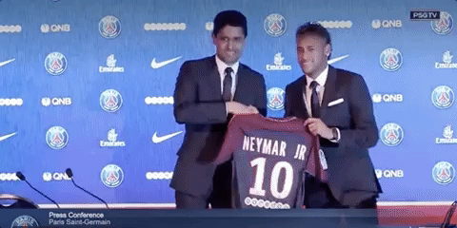
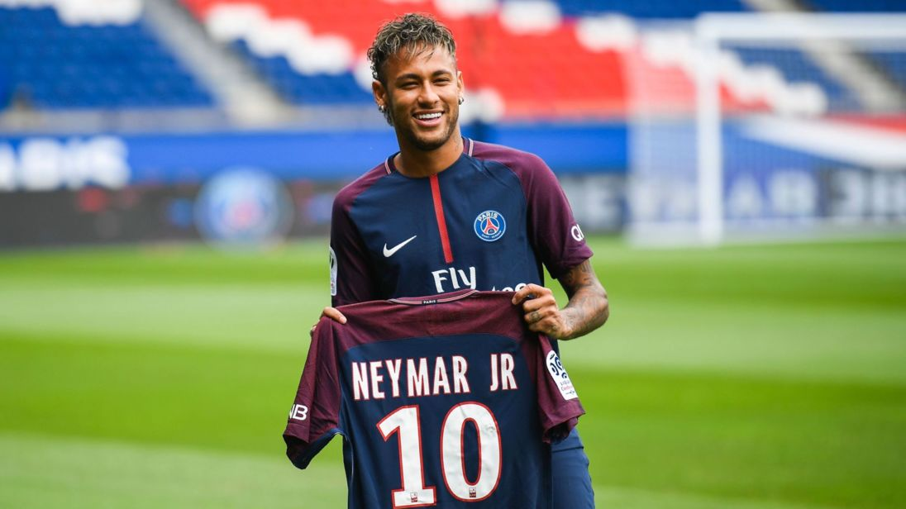


Notes:
Z

Slide 4
Overview
Objective
Build regression model to predict player’s value
Data Introduction
Data Exploration
Regression Analysis
Applications
Plan of Action
Introduce the concept of the data and the variables
Create plots to see relationship between variables
Understand the data
Run various regression models to pick predictors
Use stepwise selection to create the best model
Identify the overvalued players
Generate an optimal team

Slide 5

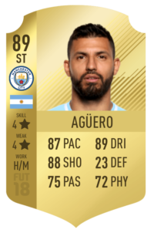

I. Data Introduction
Data consists of 435 players from 20 teams in English Premier League, the top tier soccer league in England.
Skills
Info
Age, Position, Region, Club, International Reputation, Height, Weight
FPL
fpl_value, fpl_sel, fpl_points
Overall, Pace, Shooting, Passing, Dribling, Defence, Physical

Slide 6
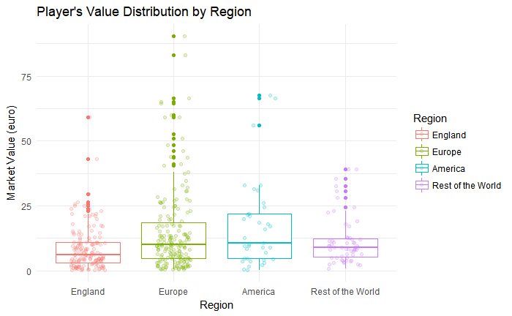
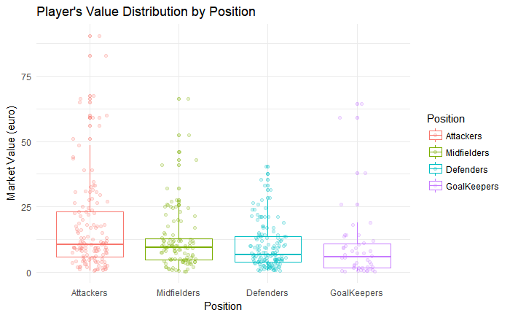
II. Data Exploration
Position | Mean_value | Max_value
Attackers | 17.29 | 90.5
Midfielders | 11.84 | 66.5
Defenders | 9.59 | 40.5
Goalkeepers | 9.52 | 64.5
Region | Mean_value | Max_value
England | 8.64 | 59
Europe | 14.93 | 90.5
America | 17.33 | 40.5
RoW | 11.57 | 64.5

Slide 7
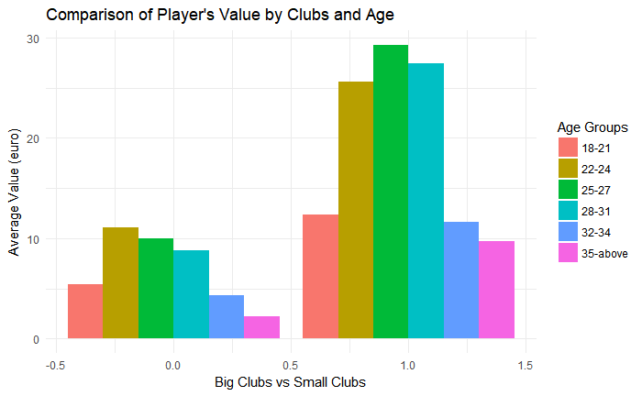
II. Data Exploration (cont)

Slide 8
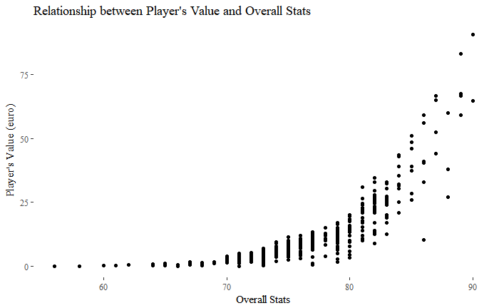
III. Regression Analysis – Set Up
Player’s Value against Overall stat in FIFA 18
The relationship is exponential.
Apply transformation (log) in the regression model.

Slide 9
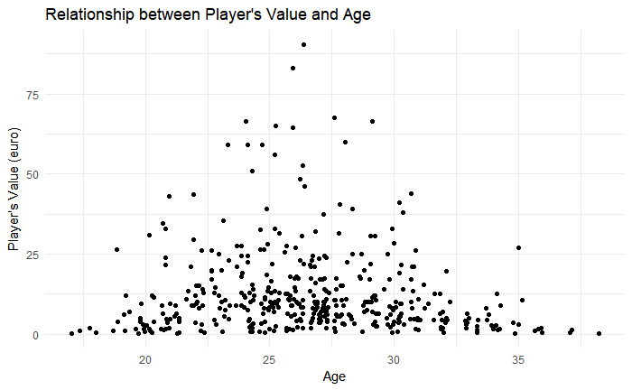
Player’s Value against Age:
The relationship is quadratic.
Apply interaction term (age^2).

Slide 10
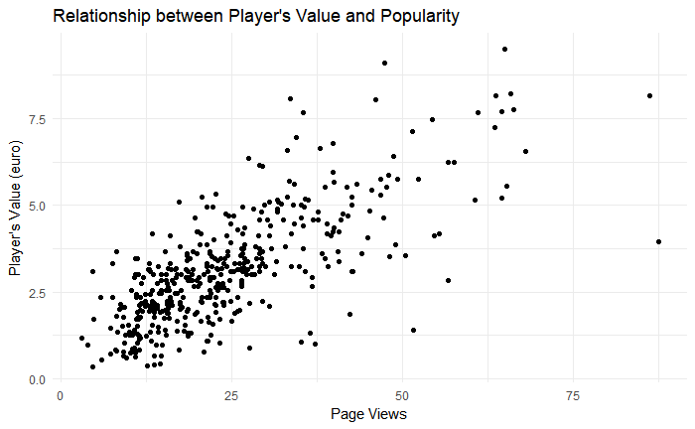
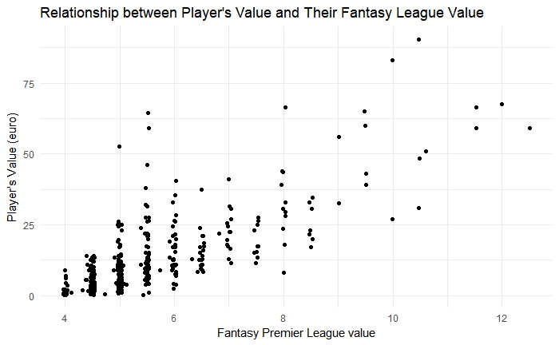
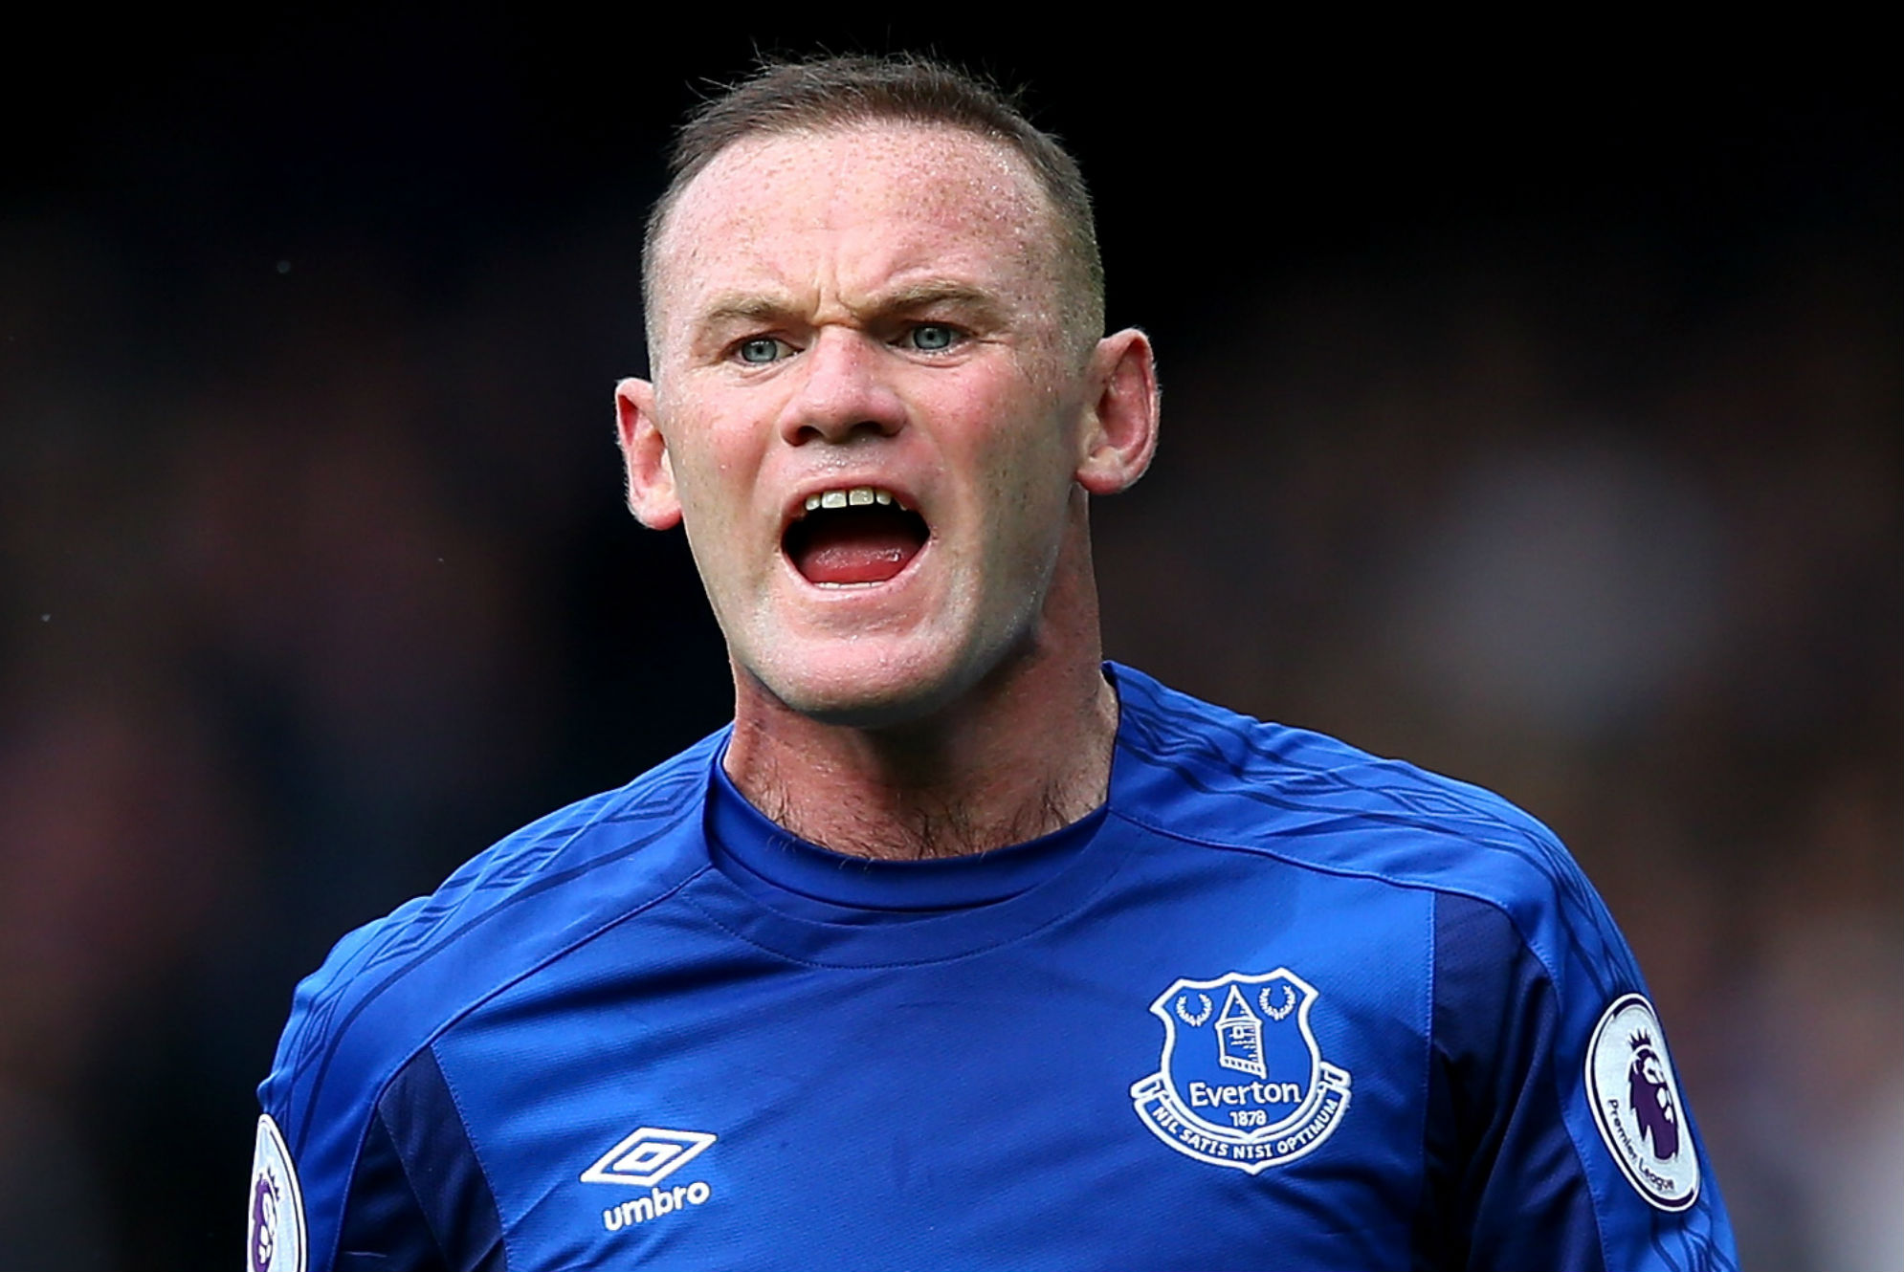
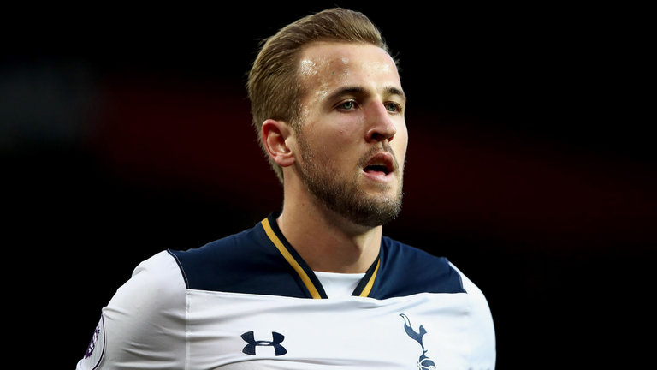
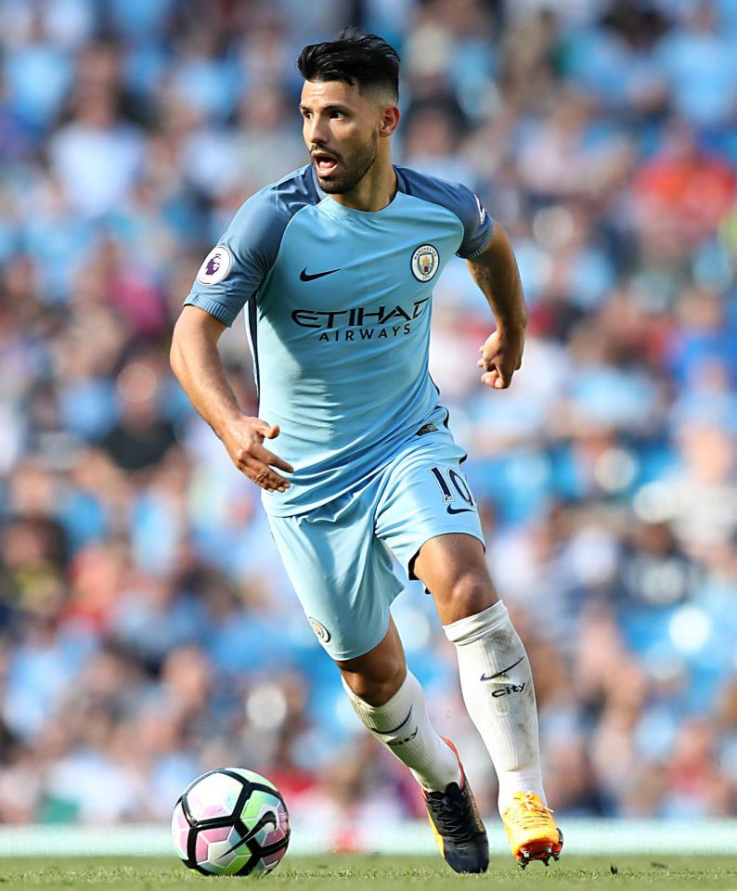
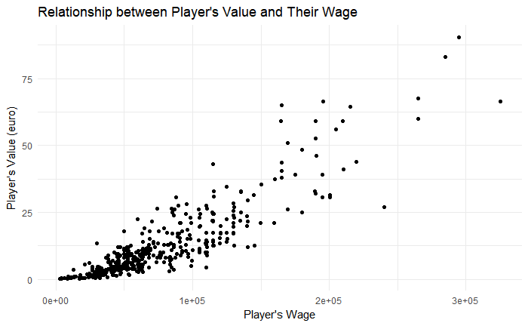
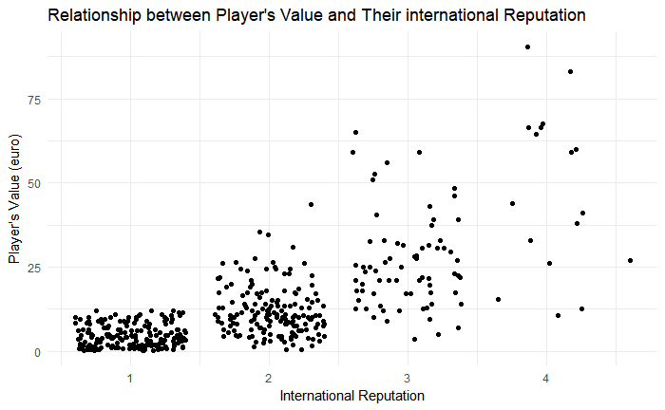
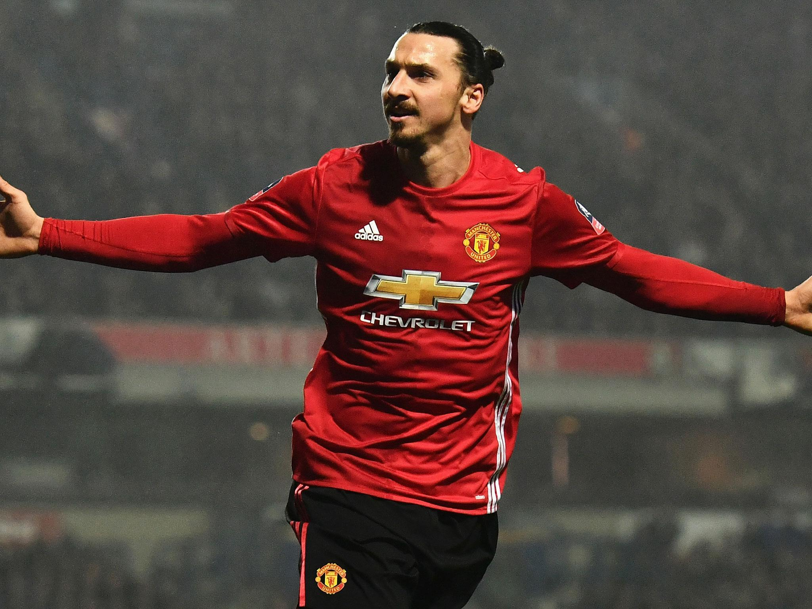
Popularity
FPL_value
Wage
International Reputation
Notes:
This is sqrt of value and sqrt of page_views

Slide 11
III. Regression Analysis – Stepwise Selection
After going through the elimination process:
Chosen Predictors for Player Market Value:
Sqrt(eur_wage), log(overall), age, agesq, fpl_value, international reputation, big_club, sho, as.factor(position)
P-value: All less than 0.05 besides “Big_club” and “Position (Defenders)”
Adjusted R-Squared: 94.3%
Predictors | Intercept | Sqrt(wage) | Log (Overall) | Age | Agesq | Int_rep | FPL Value | Mid | Def | Goal Keeper | Big Club | Sho
Coefficient | -4.84 e+01 | 4.966 e-03 | 1.126 e+01 | 1.196 e-01 | -4.481 e-03 | 2.232 e-01 | 2.790 e-01 | 1.827 e-01 | -6.122 e-02 | 4.378 e-01 | -1.159 e-01 | -6.874 e-03
Notes:
Add the stepwise regression model / the best model

Slide 12
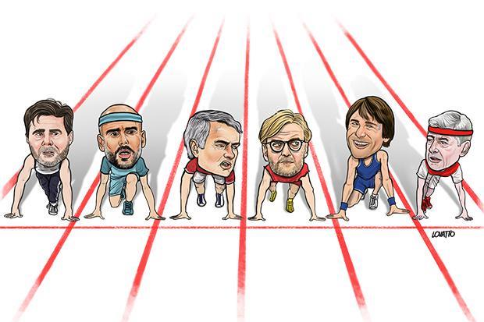

IV. Application

Slide 13
Overvalued Players in Big Team
We used the prediction model to identify the overvalued players in the top 5 teams in Premier League:
Club | Overvalued Players | League Standing (this season) | League Standing (last season)
Arsenal | 3 | 5 | 5
Chelsea | 9 | 3 | 1
Liverpool | 5 | 4 | 4
Manchester City | 6 | 1 | 3
Manchester United | 5 | 2 | 6
-14.16 -1.98 -0.36 2.27 17.57
Min
1st Q
Median
3rd Q
Max

Slide 14


Overvalued Players – Good or Bad?

Slide 15
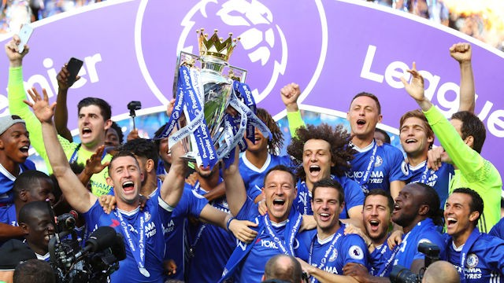
What if we can pick the optimal 15 players?
There are 15 players on Fantasy per team.
You are allowed to only have 3 at most from the same team.
You have a budget of 100.
Question: Giving these limitations, can we pick 15 players that will give us the most consistent points throughout the season of 2017/2018?
Calculated the Mean of the FPL Points of the top 15 players per position.
Calculated the Mean of the FPL Value of the top 15 players per position.

Slide 16
Mean Findings:
Notes:
1] 9.583333 [1] 5.9 [1] 5.041667 [1] 6.409091

Slide 17
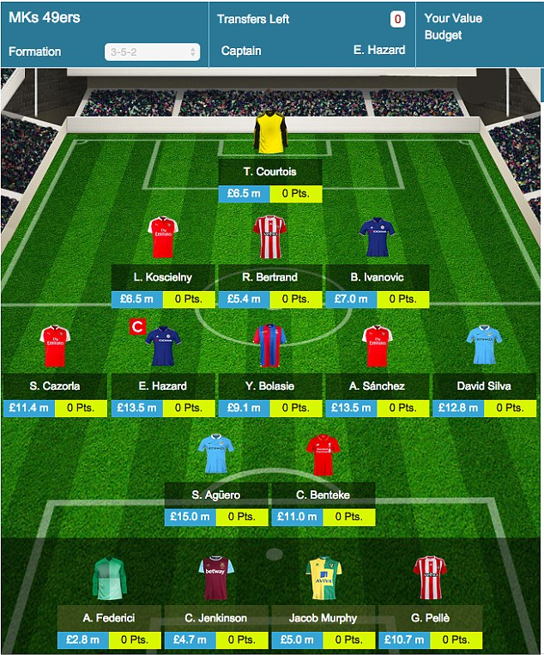
Based On The Game
We need to pick:
2 Goal Keepers (10)
4 Defenders (20)
5 Midfielders (40)
3 Attackers (30)
Our target is to get the players that have points above the average points and within the average budget per position.

Slide 18
The Optimal 15 Players To Have On Your Fantasy League Team Are:
Name | Team | Points | Value | Selection % | Position
Tom Heaton | Burnley | 149 | 5 | 13.5 | GK
Artur Boruc | Bournemouth | 120 | 4.5 | 6.9 | GK
Charlie Daniels | Bournemouth | 134 | 5 | 19.8 | LB
Gareth McAuley | West Brom | 131 | 5 | 11.8 | CB
Nathaniel Clyne | Liverpool | 129 | 5.5 | 4.5 | RB
Ashley Williams | Everton | 127 | 5.5 | 4.7 | CB
Dele Ali | Tottenham | 225 | 9.5 | 38.6 | CM
Geroginio Wijnaldum | Liverpool | 149 | 7.0 | 7.1 | CM
James Milner | Liverpool | 139 | 6.5 | 10.4 | CM
Etienne Capoue | Watford | 131 | 5.5 | 8.0 | DM
Cesc Fabregas | Chelsea | 121 | 7.0 | 7.5 | CM
Alexis Sanchez | Arsenal | 264 | 12 | 17.1 | LW
Eden Hazard | Chelsea | 224 | 10.5 | 2.3 | LW
Romelu Lukaku | Manchester United | 224 | 11.5 | 45 | CF

Slide 19
Conclusion
Money plays an important part in determining the success of a soccer team. Having overvalued players, therefore, is not necessarily a bad thing.
With a limited budget, the key of consistency in team performance is to have balance between overvalued players and undervalued players.
Future Direction:
Scout system
A more efficient model of team building

Slide 20


